Slide 1
Curve Fitting
By: Riley Adams, Serena Leung, Gianni Spiga, Sharon Vien
Notes:
Introduce ourselves, Riley leads into slide 2

Slide 2
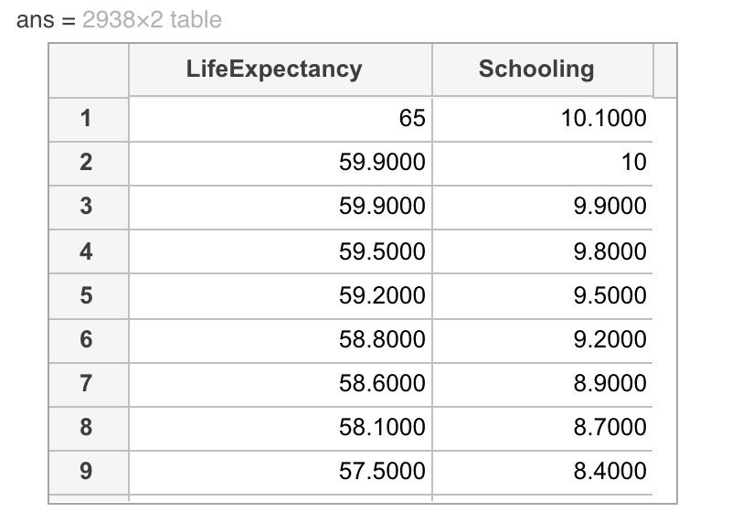
Understanding the Dataset
Life Expectancy Data - WHO
Information about the dataset
2938 x 18 table
Life Expectancy ~ Schooling
Notes:
Riley:
Data from W.H.O.
Collected from many different countries
Life Expectancy base on various factors
We chose to examine avg years of schooling against Life Expectancy

Slide 3
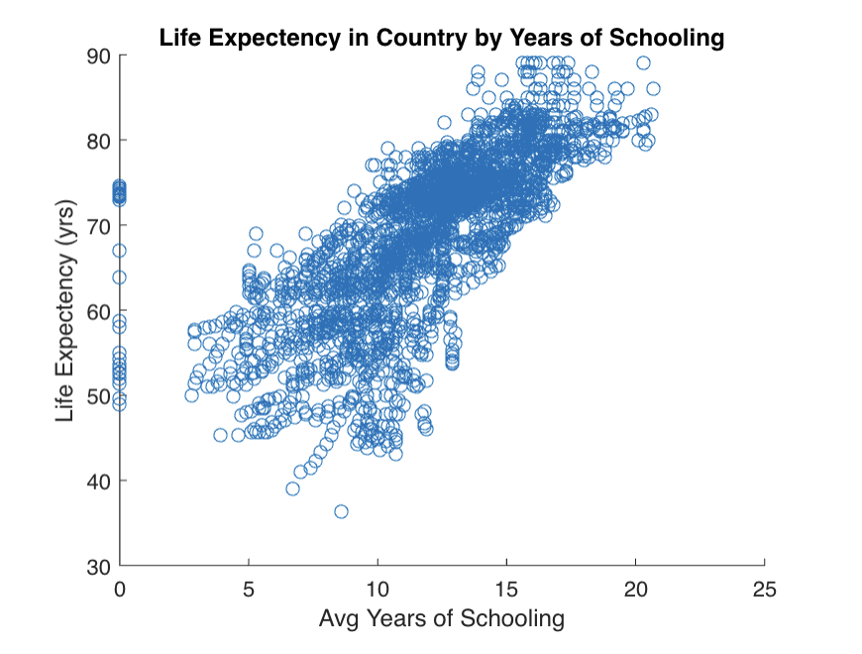
Plot of Data & Chosen Models
Linear Model
Function: linfit()
Quadratic Model
Function: quadfit()
Cubic Model
Function: cubefit()
Log Model
Function: logfit()
Notes:
Sharon
Talk about the data, what models we will use to fit, what adjustments we had to make, respective functions created, possibly talk about having to shift the data
To the left, we have a plot of our variables of interest, with life expectancy as a function of average years of schooling for all of the countries. From this plot, at first glance, there appears to be a linear relationship between the variables. Therefore we first decided to fit a linear model. However, we also wanted to see if other models could fit the data as well. So we decided to fit the quadratic, cubic, and log models.
As a result, we created functions to fit the data for each model which we will go over in the next two slides. However, from the plot, we see that some data points are on the Y axis. When taking the log of zero, its result is undefined. Therefore, we shifted those data points by 0.0001 to resolve that issue.
We decided on shifting the data by 0.0001 because it’s the smallest value that MatLab would allow in order for the value to not be 0.

Slide 4
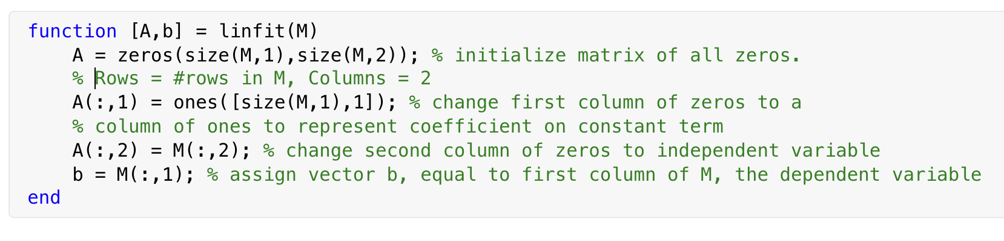
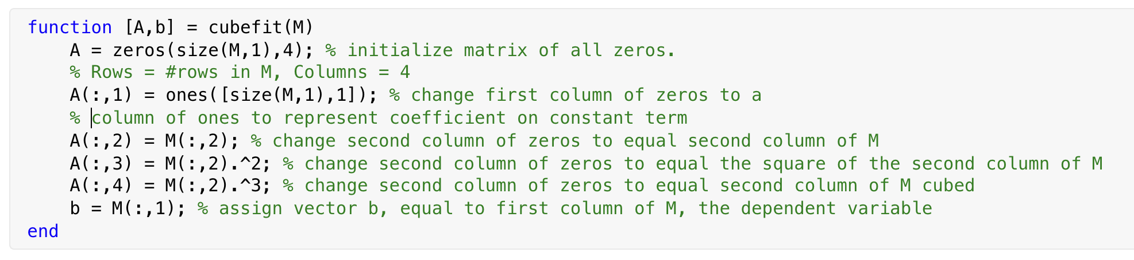
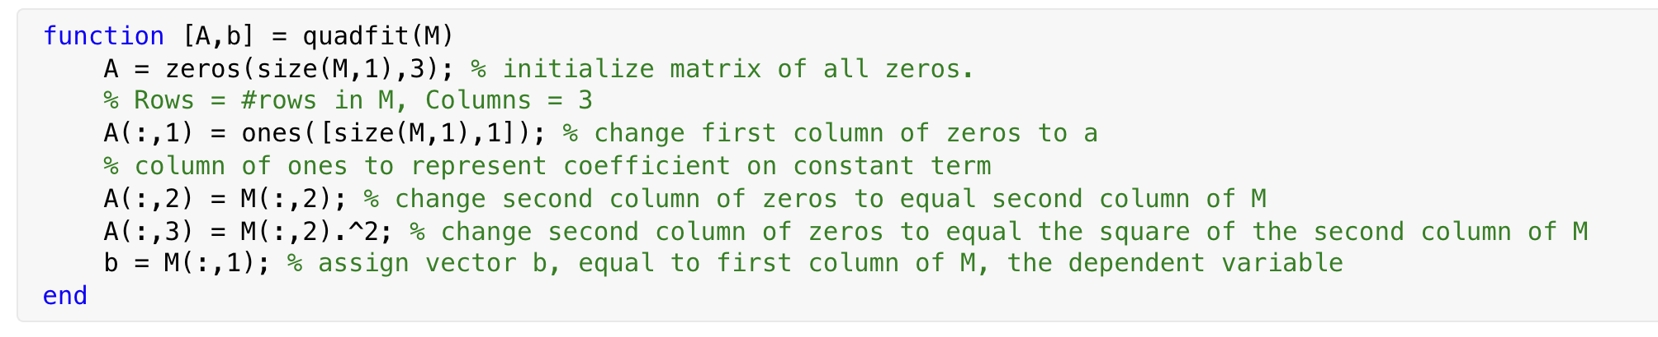
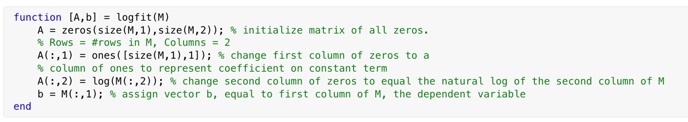
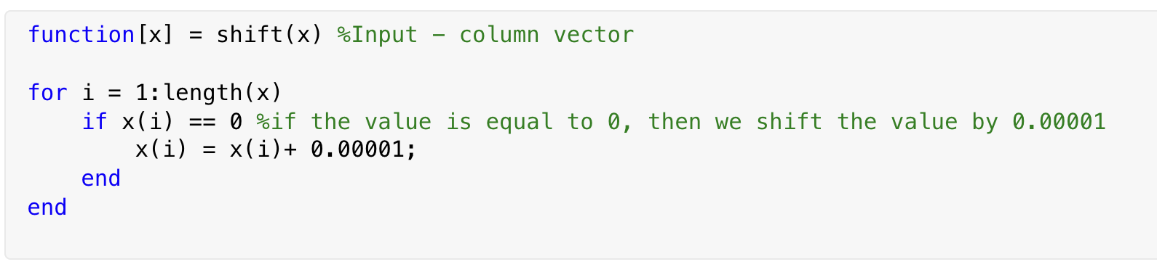
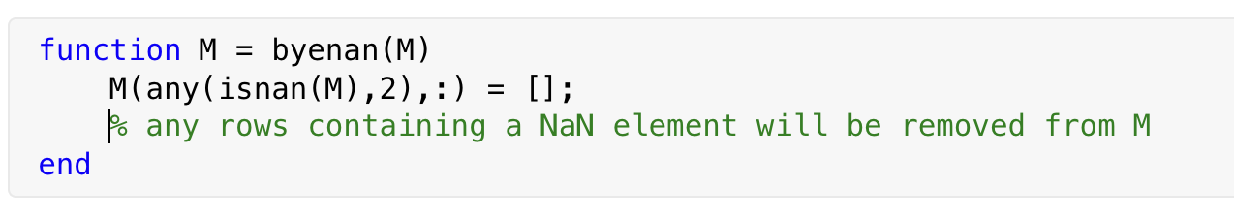
Model Fitting Code
Notes:
Riley

Slide 5
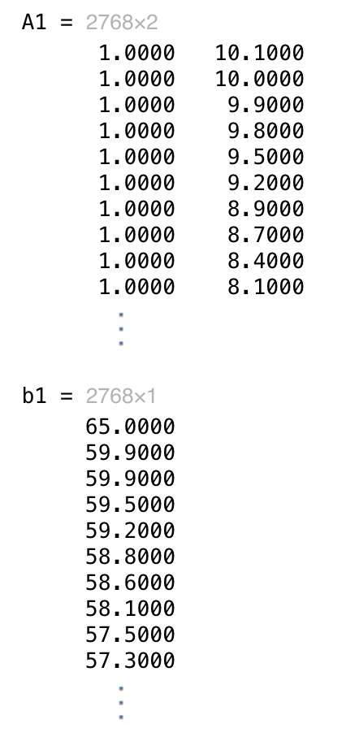
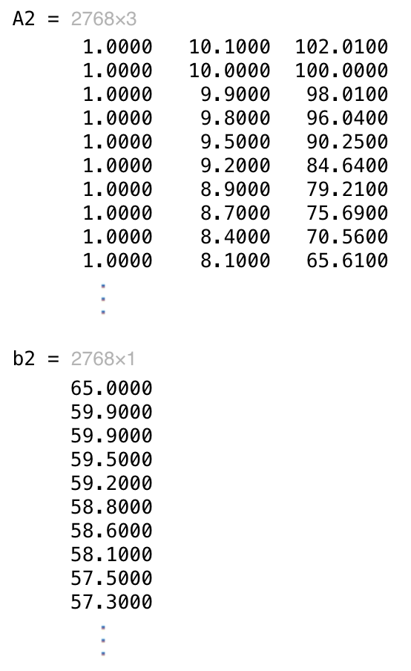
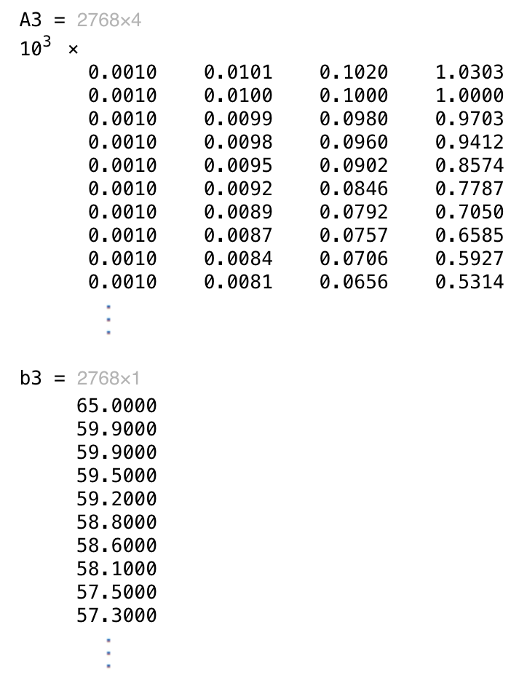
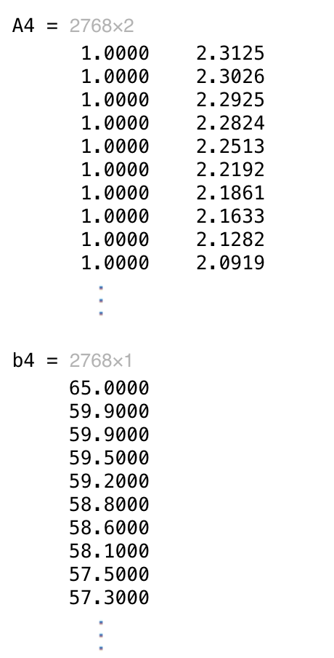
Fitting the Models
Linear Model
Quadratic Model
Cubic Model
Log Model
y = mx + c
A1 = [ 1 x ]
y = ax² + bx + c
A2 = [ 1 x x² ]
y = ax³ + bx² + cx + d
A3 = [ 1 x x² x³ ]
y = mln(x) + c
A4 = [ 1 ln(x) ]
Notes:
Serena
As sharon mentioned, we’d like to test for a linear, quadratic, cubic, log relationship between life expectancy and schooling
To fit our data to these models, we need to create the starting A matrix
1st col: intercept
2nd col: schooling

Slide 6
Least Squares Problem Utilizing Various Algorithms
Pseudoinverse
QR Decomposition
Classical Gram Schmidt
Modified Gram Schmidt
Householder Triangularization
SVD
Notes:
Sharon
For least squares problem, we solve Ax = b when A is a p by q matrix where p is > q and b is a column vector. If the rank of A is q, thus full rank, then there is exactly one solution for x which is = (A^tA)^1 * (A^Tb). However, since our matrix A is an overdetermined system, there is no exact solution x to solve for b. We can only use x to approximate for b.
Pseudoinverse: Our first approach is to use the normal equation where (A^tA)^1 * (A^T) is the Moore-Penrose Pseudoinverse.
QR Decomposition: Sometimes, using the normal equation of x = (A^tA)^1 * (A^Tb) isn’t ideal because it involves finding the inverse. For large matrices, computing the inverse is inefficient and can lead to numeric error and thus a loss of information. Therefore, we utilize QR factorization to also solve for the least squares problem.
SVD: Lastly, we can also use Singular Value Decomposition to decompose A and find a solution x. We can solve for X by using V*[diag(S)]*(U^T)*(b)
We also considered using Givens Rotation, but using a Givens rotation would not have been appropriate for our data. Givens rotation is faster than other methods with sparse matrices and while our data did contain some zeroes, it was not a significant amount to justify using a Givens Rotation Matrix.

Slide 7
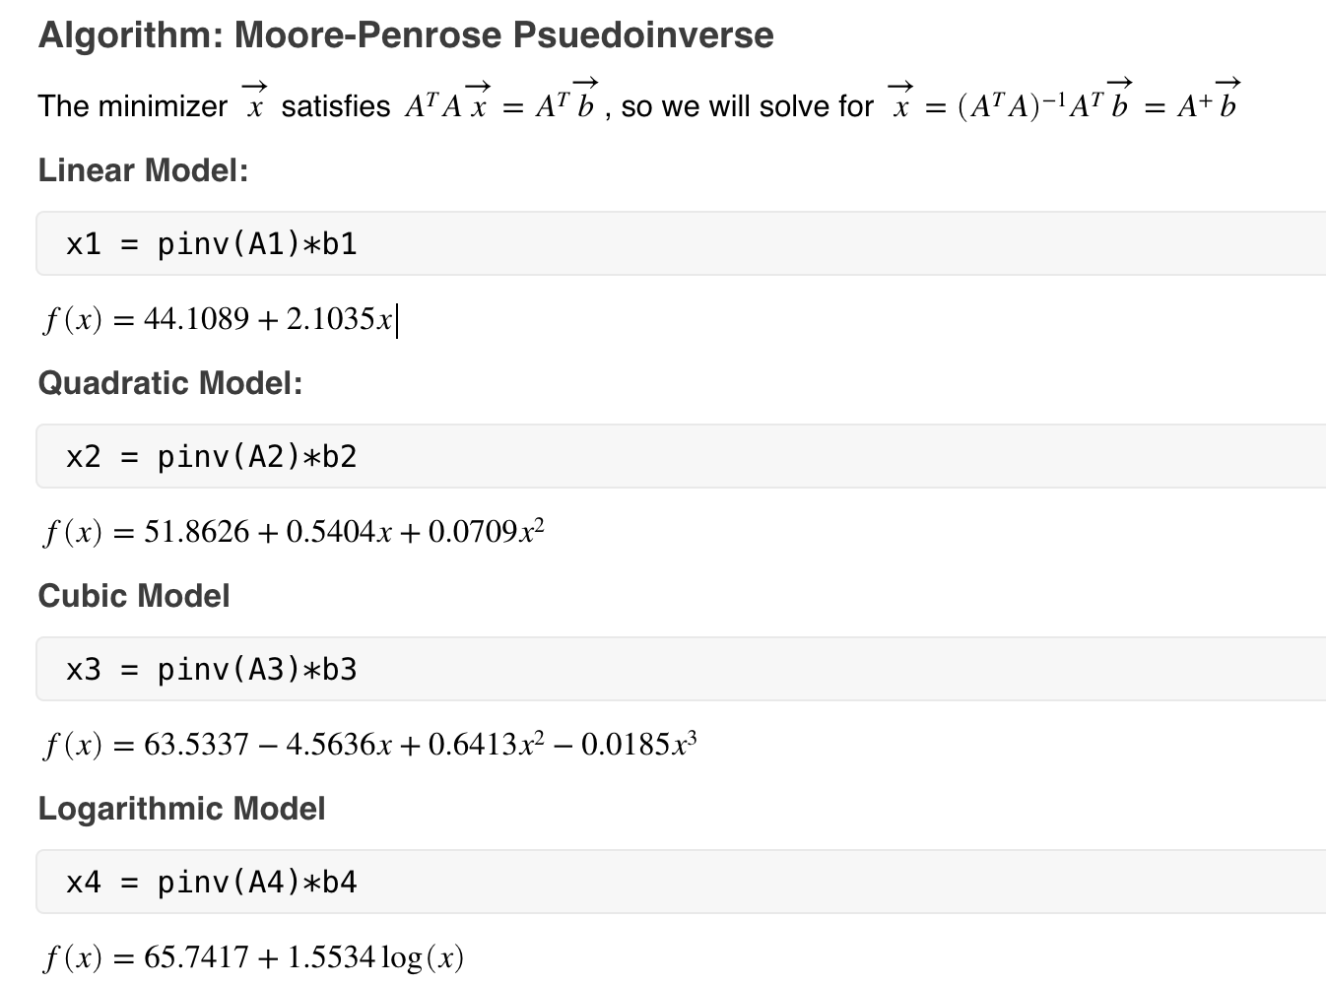
Pseudoinverse
Notes:
Riley
Most simple, least numerically stable.

Slide 8
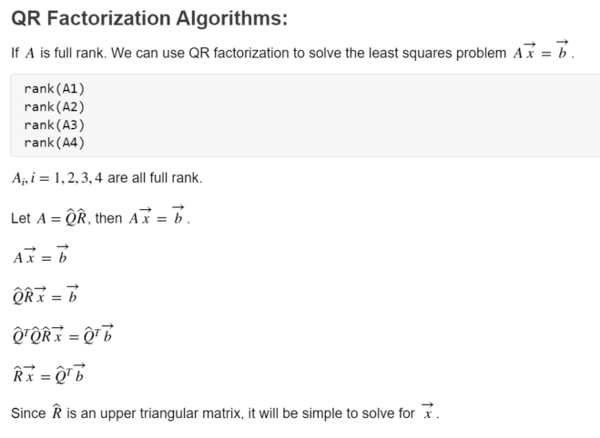
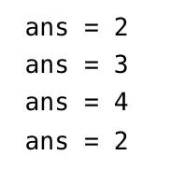
QR Factorization Algorithms
Notes:
Serena
Normal equation At Ax = At b requires A to be of full rank for the normal equation to hold true
Distribute the transpose
Q is an orthogonal matrix: Property Q^t Q = Identity matrix
The same applies for full and reduced QR factorization

Slide 9
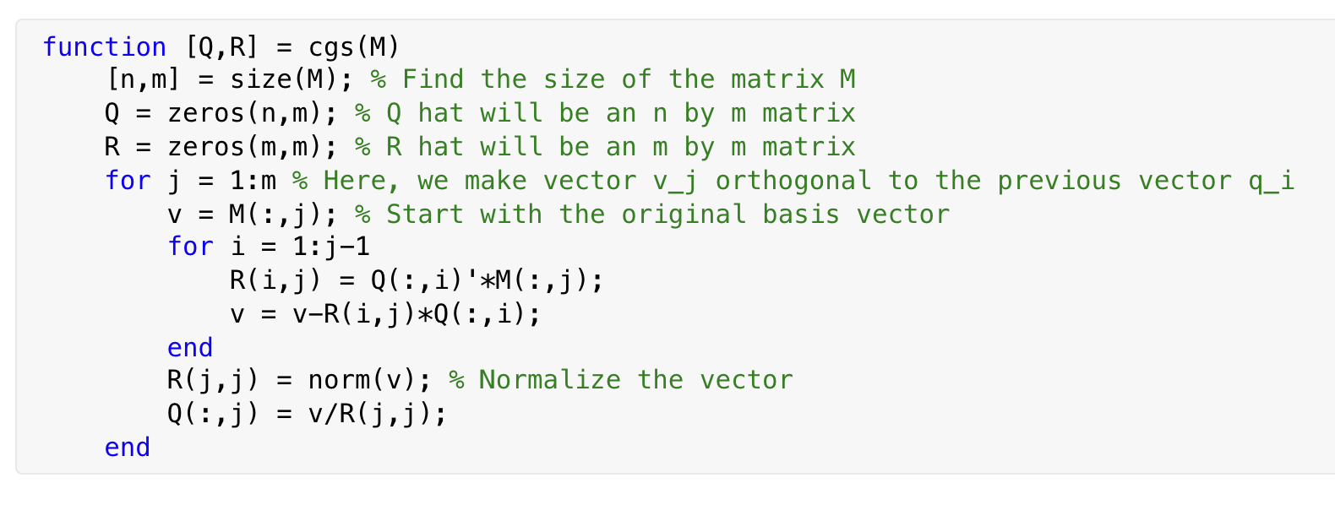
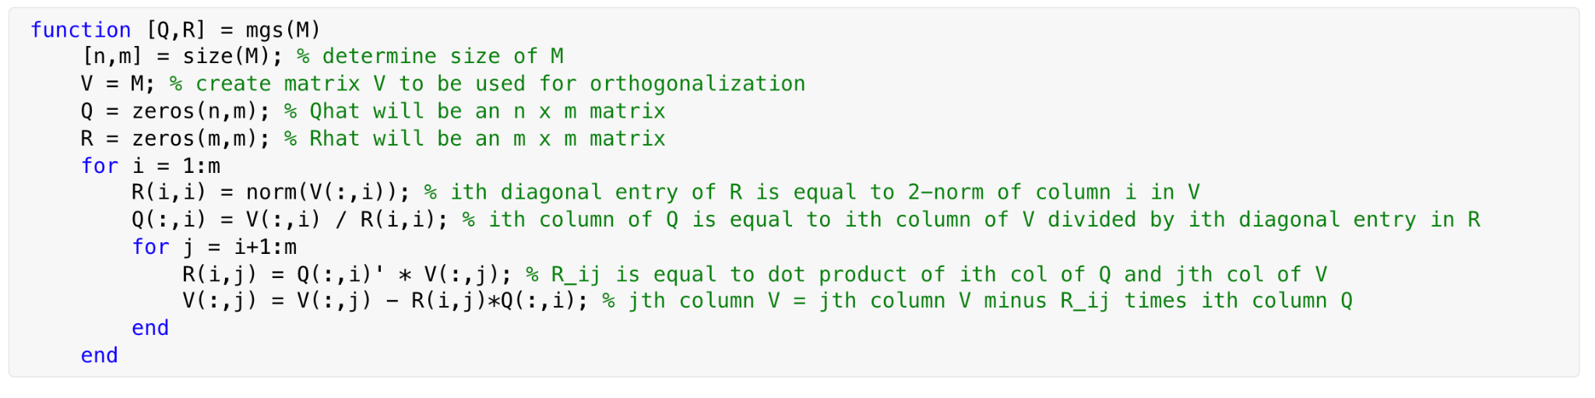
Classical Gram Schmidt and Modified Gram Schmidt
Notes:
CGS: Sharon
One of the first QR Factorization Algorithms is Classical Gram Schmidt. In this CGS function, we take an input matrix M and we output Q hat and R hat. First, we find the size of matrix M and set the size of Q hat and R hat based on n and m. In this case, Q hat will be an n by m matrix and R hat will be an m by m matrix. In the following for loop, we make vector j orthogonal to the previous vector q sub i and we start with the original basis vector. Then, we normalize the vector, and create q sub j = to v_j divided by its norm.
MGS: Riley
Equal in exact arithmetic, differ in floating point arithmetic
MGS is more numerically stable than CGS, because the errors don’t compound.
First normalize a vector, then make all subsequent vectors orthogonal to that vector. Then repeat.

Slide 10
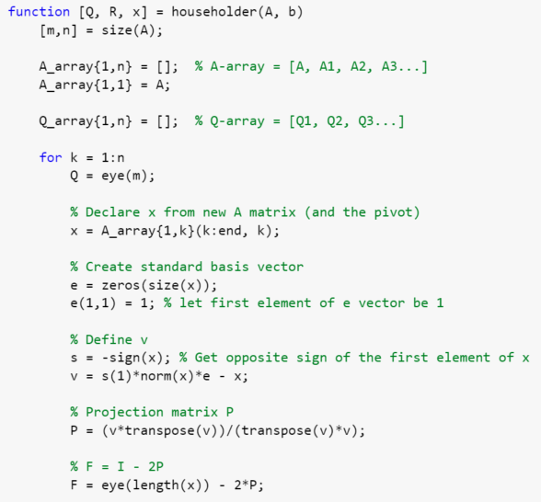
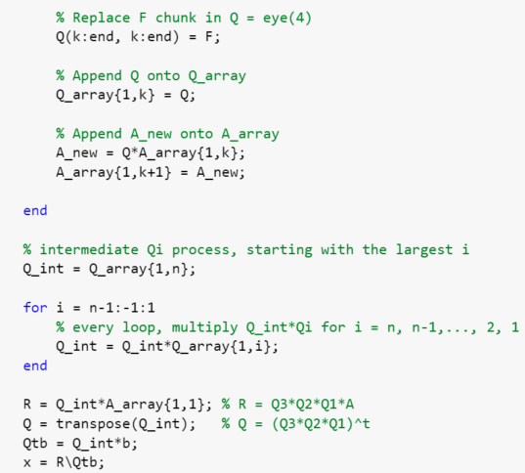
Householder Triangularization
Notes:
Serena:
F = Householder Reflector

Slide 11
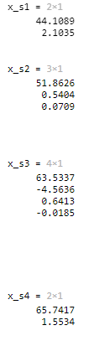
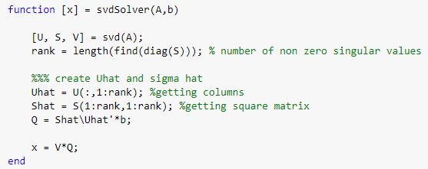
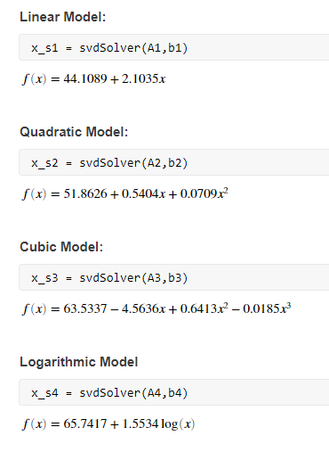
Singular Value Decomposition (SVD)
Code
Code Output
Function to solve for the vector x given a matrix A and a vector b via SVD
Notes:
Gianni:
We can also find a solution for our curve fitting use Singular Value Decomposition. We know that SVD is not as computationally fast as other methods such as QR factorization. However SVD can be more reliable in different ranks and conditions of A.
We can first use the svd() function in Matlab to decompose A, which is an overdetermined system. After, we can create a reduced matrix U hat and Sigma hat to solve for a matrix Q, a solution to the linear equation Sigma hat * Q = U hat *b. Finally we get the multiplication of V and our matrix Q, which is a notation relating to the pseudoinverse of A represented as V*SigmaHat^-1 * U hat transpose which is then multiplied by b. This will allow us to find a solution vector x that approximates b. On the right of the screen, you can see the vectors that we solved for in each model, which as Serena will discuss in the next slide, look nearly identical to the results of our other algorithms.

Slide 12




AND TABLES TO COMPARE DATA
Results | All Methods
Linear Model
Quadratic Model
Cubic Model
Log Model
Each method gave us nearly the same results for all models.
Why?
A is computationally inexpensive because it does not have many columns
MGS, Householder are normally alternatives to CGS because they are more numerically stable
In this case, the differences in error were small enough that the estimates matched up until 10th decimal point of precision.
Notes:
Serena w
Since A does not have many columns, the rounding errors of each intermediate step has not built up to the point where it severely affects our estimated models
We did not find any difference between the methods → indicate that the steps to solving for vector x is computationally inexpensive
In general, coefficients matched up until the 10th decimal

Slide 13
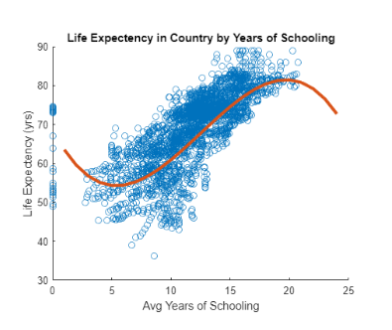
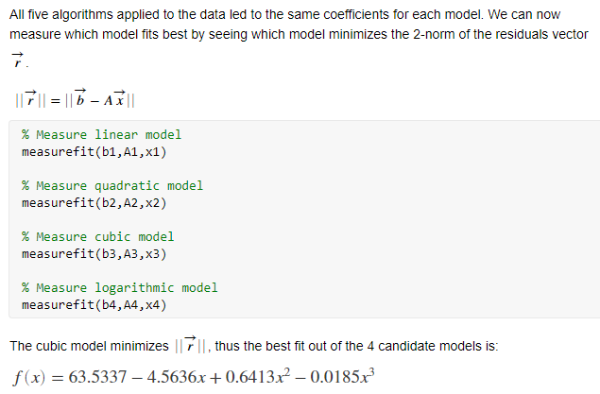
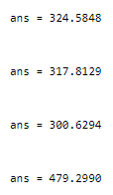
Determining the Best Fitting Model
Notes:
Sharon
Like Serena said, each method gave us nearly the same results for all models.
As mentioned before, the best fit for our model is one that minimizes the 2 norm of the residuals. We created a measurefit function that takes in b, A, and x, and computes the 2 norm of r. After, we applied this function to all our models. Surprisingly, we find that the cubic model is the best fit for our data as it results in the smallest value for the residuals.
To the right, we plotted the data against the curve of our cubic model.

Slide 14

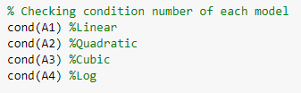

Condition Number and Noise
Condition Number
Noise
We observe the condition numbers of our models:
In conclusion, we found that the addition of various amounts of noise increased the residuals of our models, leading to a worse fit (regardless of algorithm).
Notes:
Gianni:
After examining our models and establishing a best fit, we observed our condition numbers for each model. If A is ill-conditioned, it will result in residuals that are not a good indicator of accuracy.
Our models, in regards to the condition number, lie in a grey area.,This left us uncertain as to define whether these models were ill conditioned or well conditioned. However, we still desired to improve our model if possible.
Given our range condition numbers for our four models, we decided to to add noise to these models via a function to each respective b vector to test if we could increase the accuracy. The reasoning behind this is so that, since our condition number is a measure of how much a small change in input affects the output, we would want to see if there was a change in the model residual. In this case, input was adding noise to the vector b and the output was our coefficient vector x.
Unfortunately, the addition of noise however increased our residuals slightly, thus hurting our model’s accuracy.

Slide 15
Conclusion Slide
Given our chosen model, we can best predict the average life expectancy of a citizen in a given country based on the following equation:
Where x is the average years of schooling of said country.
f(x) is the average life expectancy of the country.
Notes:
Gianni:
In conclusion, we found that our best fitting curve remained to be our original cubic model, with no additional noise, based on having a minimized residual. This model allows us to most accurately predict the life expectancy of any given country as a function of average years of schooling with the equation shown.
We thank you so much for your time.

Slide 16
SlidesCarnival icons are editable shapes.
This means that you can:
Resize them without losing quality.
Change line color, width and style.
Isn’t that nice? :)
Examples:

Slide 17
DIAGRAMS AND INFOGRAPHICS

Slide 18

Free templates for all your presentation needs
For PowerPoint and Google Slides
100% free for personal or commercial use
Ready to use, professional and customizable
Blow your audience away with attractive visuals

